Slide 1
CSS- Cascading Style Sheet

Slide 2
CSS
The CSS1 specification was developed in 1996
CSS2 was released in 1998
CSS3 is on its way
CSSs provide the means to control and change presentation of HTML documents
CSS is not technically HTML, but can be embedded in HTML documents
Style sheets allow you to impose a standard style on a whole document, or even a whole collection of documents
Style is specified for a tag by the values of its properties

Slide 3
INTRODUCTION
CSS handles the look and feel part of a web page.
Can control the color of the text, the style of fonts, the spacing between paragraphs, how columns are sized, what background images or colors are used, layout designs, etc.
Saves time, pages load faster, multiple device compatibility, reusable.

Slide 4
SYNTAX
Selector − A selector is an HTML tag at which a style will be applied. This could be any tag like <h1> or <table> etc.
Property − A property is a type of attribute of HTML tag. Put simply, all the HTML attributes are converted into CSS properties. They could be color, border etc.
Value − Values are assigned to properties. For example, color property can have value either red or #F1F1F1 etc.

Slide 5
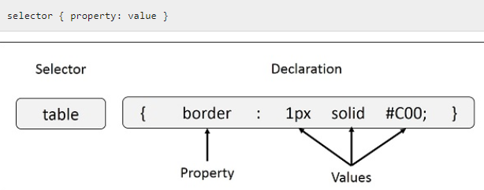

Slide 6
THREE WAYS TO USE CSS
Inline Style - CSS is placed directly into the XHTML element.
Internal Style Sheet - CSS is placed into a separate area within the <head> section of a web page.
External Style Sheet - CSS is placed into a separate computer file and "connected" to a web page.

Slide 7

EXTERNAL STYLE SHEET
For external style sheets, a <link> tag is placed at the beginning of the <head> section of the document specifying the external style sheet (with a .css extension) to be used for formatting.
rel - Specifies the relationship between the current document and the linked document

Slide 8
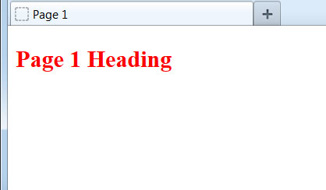

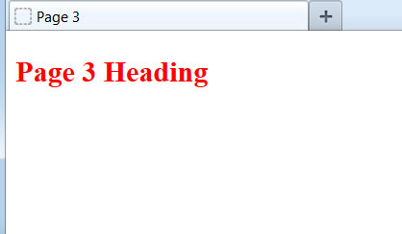
Benefit of External Style Sheet
The real power of using an external style sheet is that multiple web pages on our site can link to the same style sheet:
h2 {color:red;}
style.css :
page1.html
page2.html
page3.html
Styles declared in an external style sheet will affect all matching elements on all web pages that link to the style sheet. By editing the external style sheet, we can make site-wide changes (even to hundreds of pages) instantly.

Slide 9
INLINE STYLE
An inline style may be used to apply a unique style for a single element.
Style attribute is added to the relevant element.
A semicolon must follow each style declaration.

Slide 10
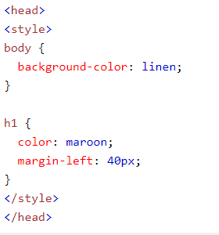
INTERNAL STYLE SHEET
Internal styles are defined within the <style> element, inside the <head> section of an HTML page

Slide 11
Internal vs. External Style Sheets
Internal Style Sheets
are appropriate for very small sites, especially those that have just a single page.
might also make sense when each page of a site needs to have a completely different look.
External Style Sheets:
are better for multi-page websites that need to have a uniform look and feel to all pages.
make for faster-loading sites (less redundant code).
allow designers to make site-wide changes quickly and easily.

Slide 12
What is Meant by "Cascading"?
Priority system is used to determine which format to display on the page
We use the term cascading because there is an established order of priority to resolve these formatting conflicts:
Inline style (highest priority)
Internal style sheet (second priority)
External style sheet (third priority)
Web browser default (only if not defined elsewhere)

Slide 13
CSS SELECTORS
Primary Selectors
Nested Selectors
Multiple Selectors
Pseudo Selectors

Slide 14

Primary Selectors
Select by tag

Slide 15

Universal Selectors

Slide 16
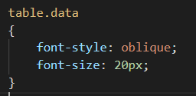
Class Selectors

Slide 17
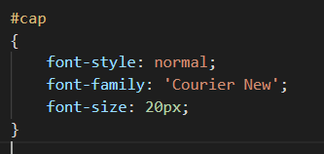
ID Selectors

Slide 18

Nested Selectors
Descendant Selectors
The descendant selector matches all elements that are descendants of a specified element.

Slide 19

Child Selectors
The child selector selects all elements that are the immediate children of a specified element.

Slide 20
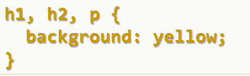
Multiple selector

